Slide 1

AI Based Smart Attendance System
Group No. 20
Jayesh Bhosale : 17104014
Tejas Bhanushali : 17104031
Yash Gangani : 18204009
Project Guide : Prof. Anagha Aher
Co-guide : Prof. Neha Deshmukh

Slide 2
Contents
Introduction
Objectives
Problem Definition
Technological Stack
Proposed System Architecture/Working
Prototype Design Demonstration
Plan of Paper Publication

Slide 3
Introduction
One necessary component of every education system is recording students attendance.
The entire process could be time consuming if it is managed manually.
Automation of recording student’s attendance is beneficial for faculties as well as students and parents too.

Slide 4
Objectives
To develop a smart attendance management system using facial recognition that will take care of the problems which are being faced in manual attendance systems.
To develop a message alert system to notify parents about ward's attendance.
To make a dashboard to review and visualize attendance of a student.
To make it useful not only to wards but also to faculties for scheduling or rescheduling the lectures.

Slide 5
Problem Definition
To record the attendance can be a great burden on the faculties if it is done by manually, and sending report of each student's attendance to respective parents also becomes tedious.
To schedule the lectures for faculties at given time slot becomes easy.
To provide visualization of ward’s attendance can be easily done by parents.
By utilizing this framework, the problem of proxies and students being marked present even though they are not physically present can easily be solved.

Slide 6
Technological Stack
Software and Languages:
Python3 (libraries required OpenCV and Chart.js).
HTML, CSS.
MySQL.
Flask web framework
Algorithms used in face detection and recognition process:
HCC (Haar Cascade Classifier)
Hardware:
Webcam.
CCTV Camera.

Slide 7
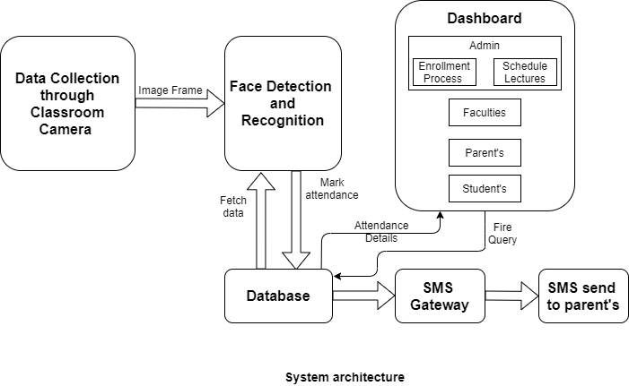
Proposed System Architecture/Working
Architecture:

Slide 8
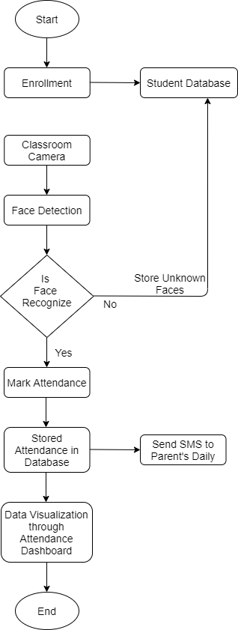
Proposed System Architecture/Working
Flowchart

Slide 9
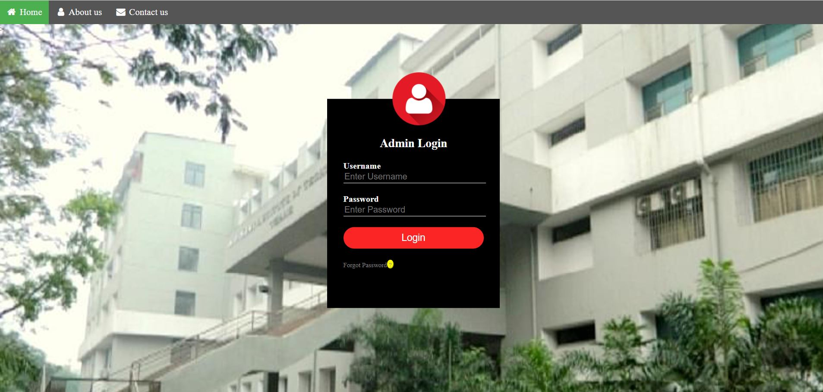
Prototype Design Demonstration
Admin login:

Slide 10

Prototype Design Demonstration
Parent’s login:

Slide 11
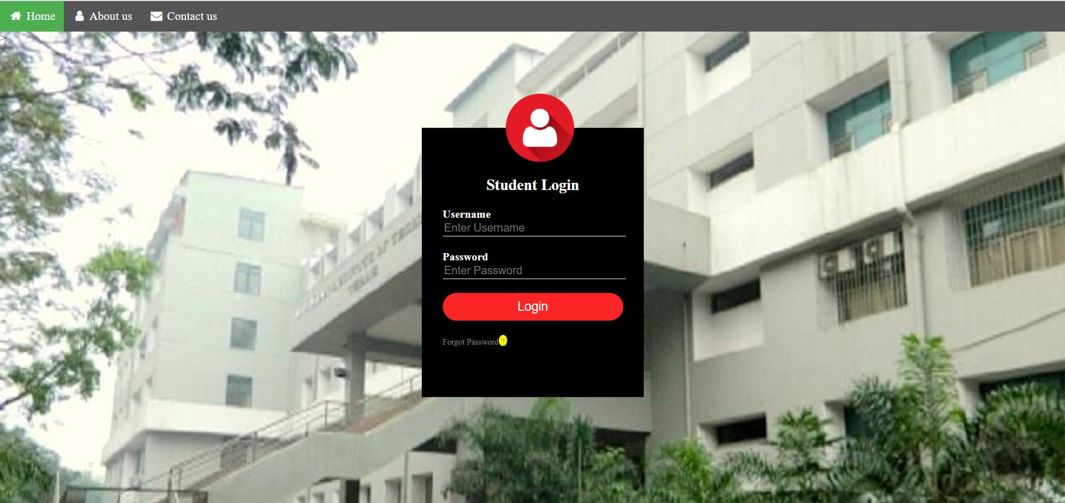
Prototype Design Demonstration
Student login:

Slide 12
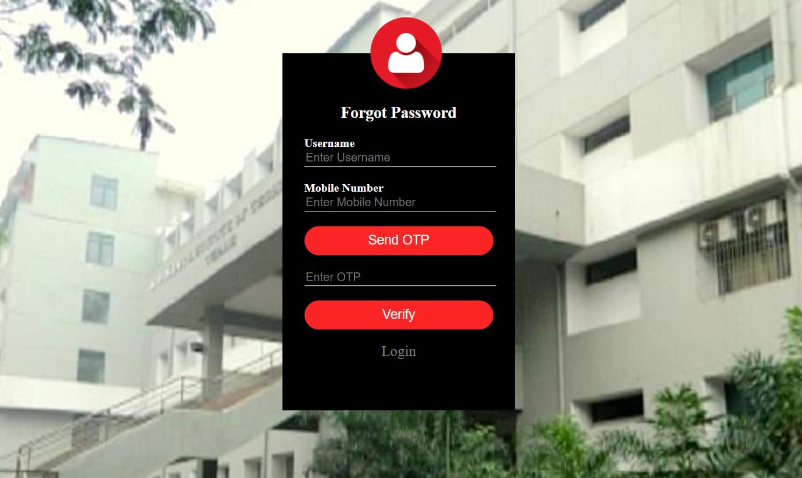
Prototype Design Demonstration
Forgot password:

Slide 13
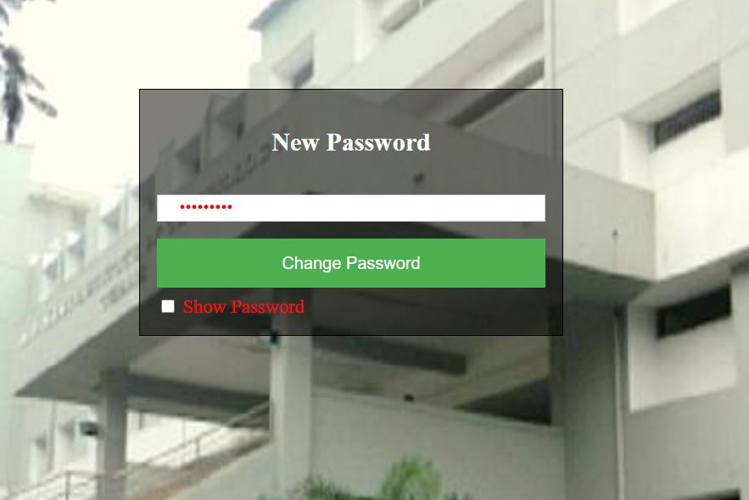
Prototype Design Demonstration
New password:

Slide 14
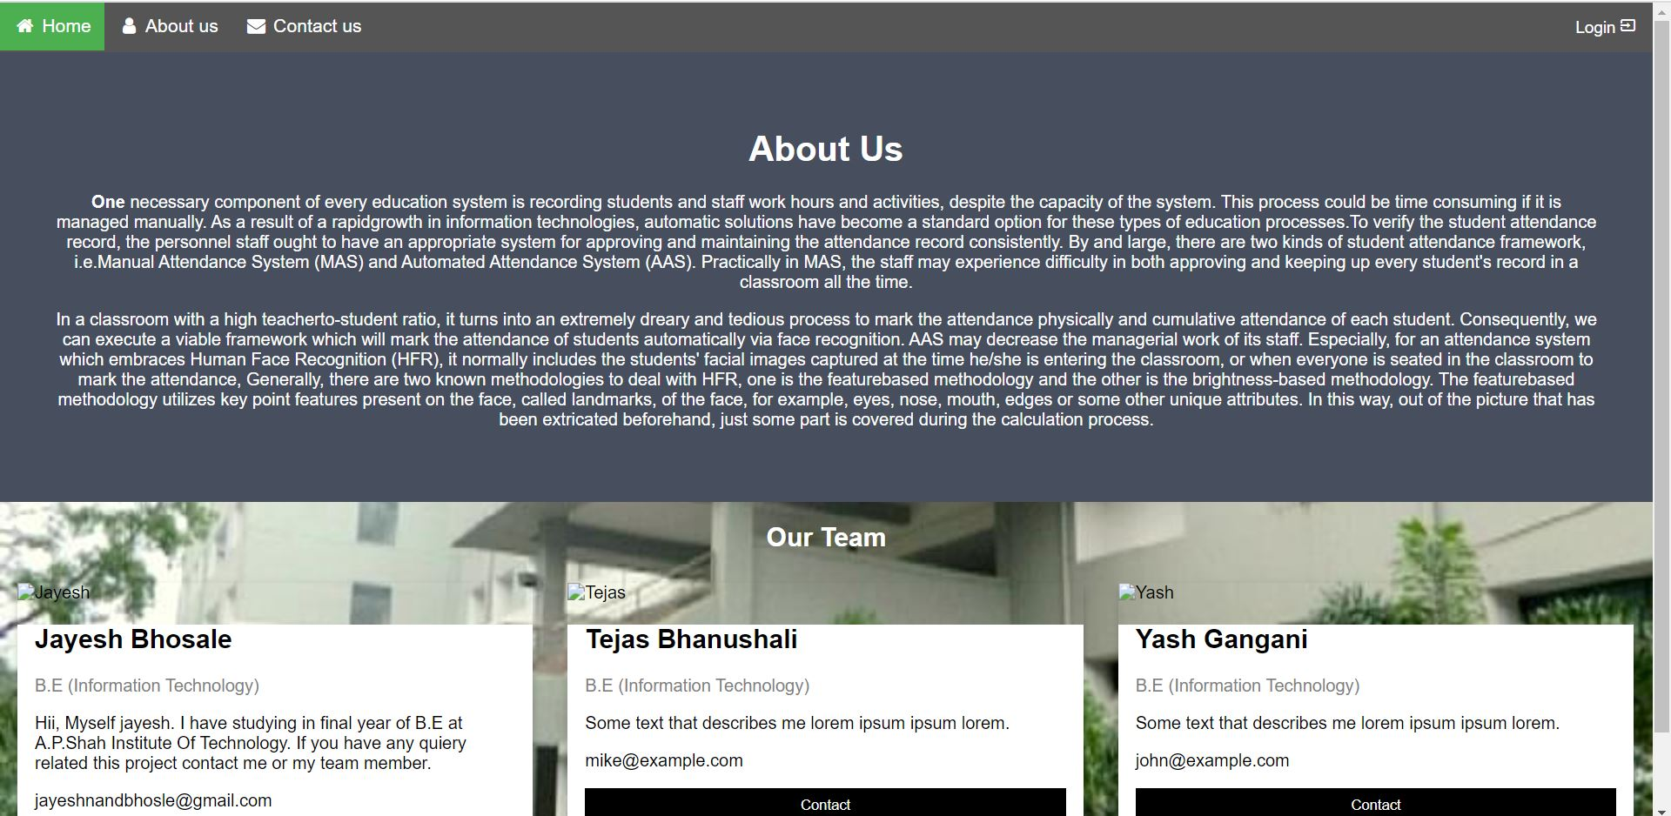
Prototype Design Demonstration
About us:

Slide 15
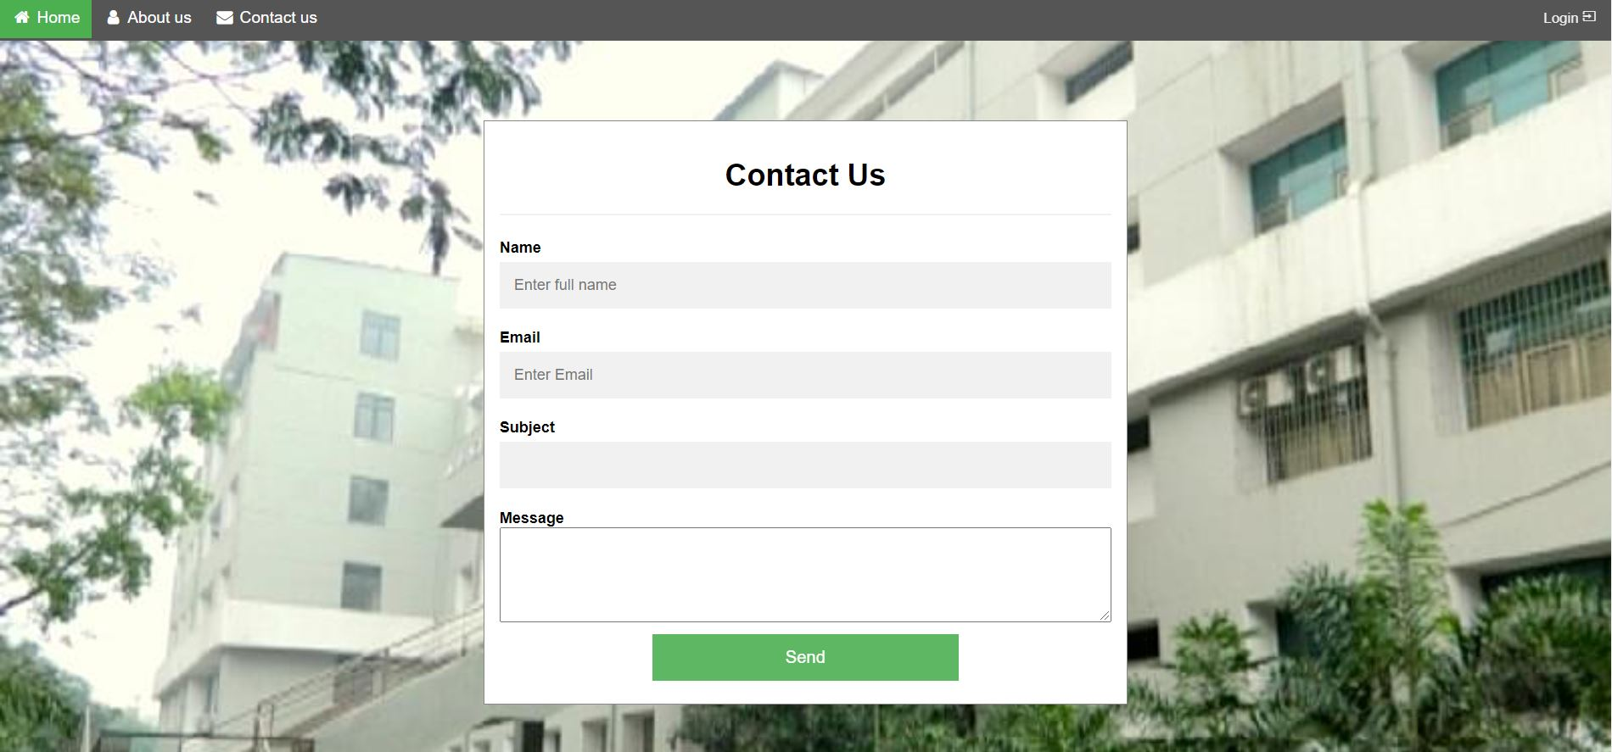
Prototype Design Demonstration
Contact us:

Slide 16
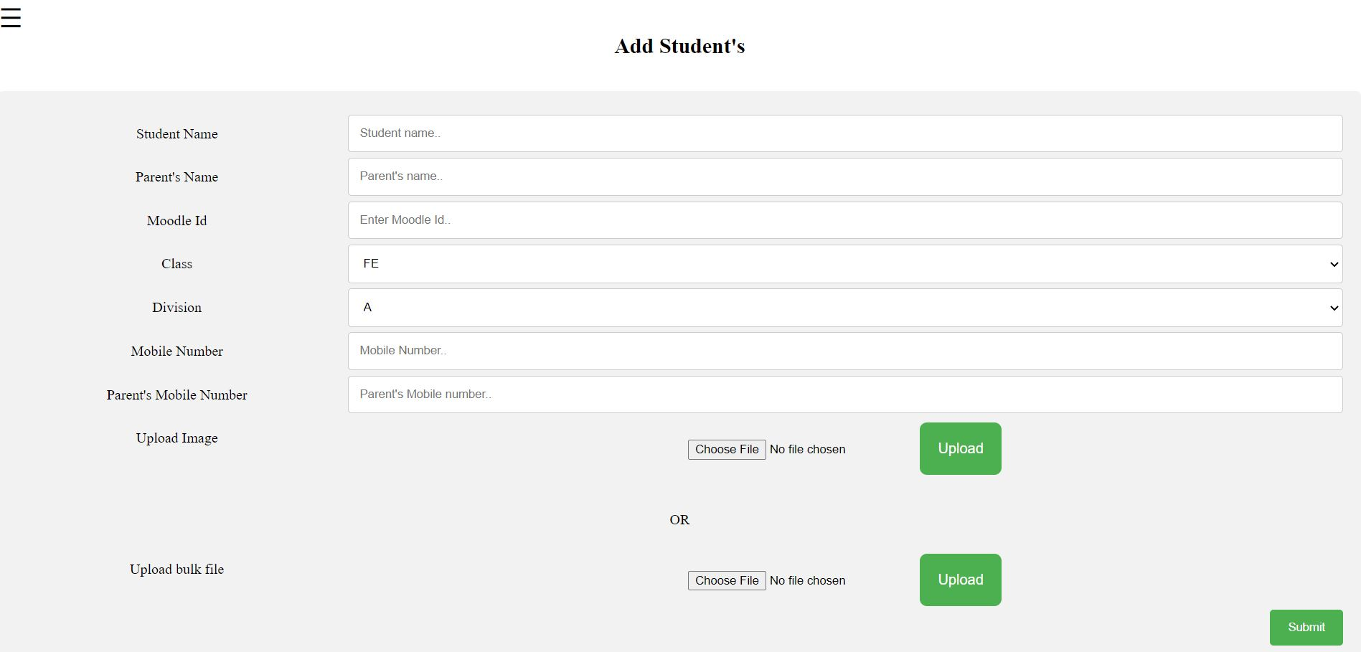
Prototype Design Demonstration
Student Registration:

Slide 17
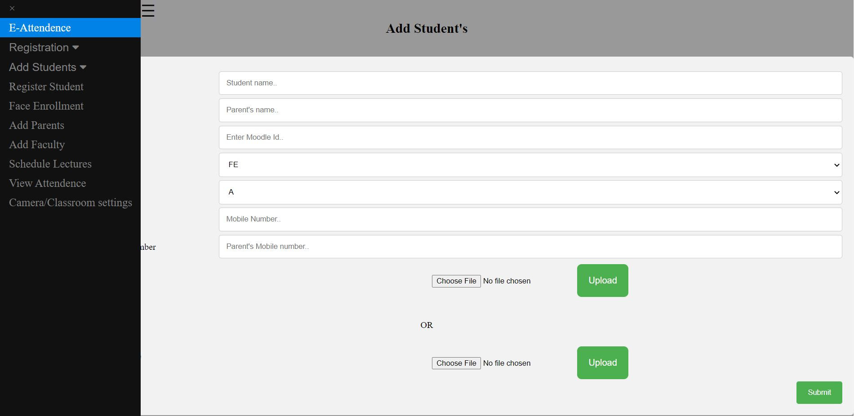
Prototype Design Demonstration
Student Registration:

Slide 18
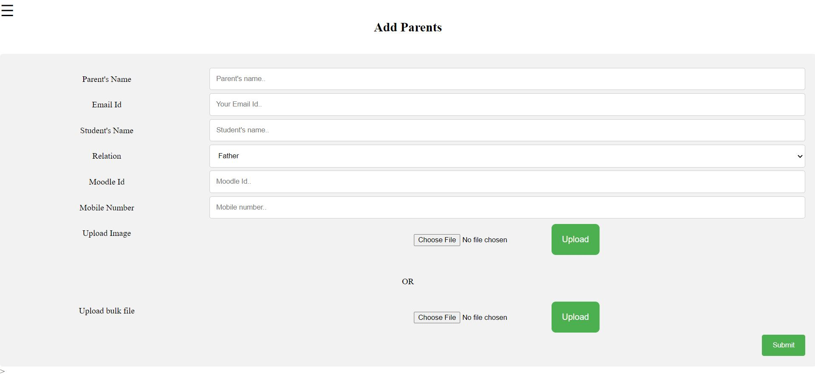
Prototype Design Demonstration
Parent’s Registration:

Slide 19
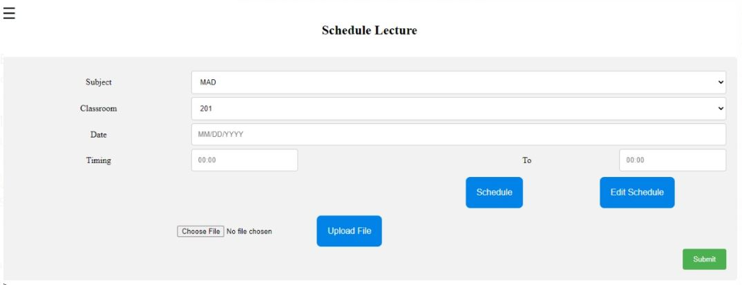
Prototype Design Demonstration
Schedule Lectures:

Slide 20
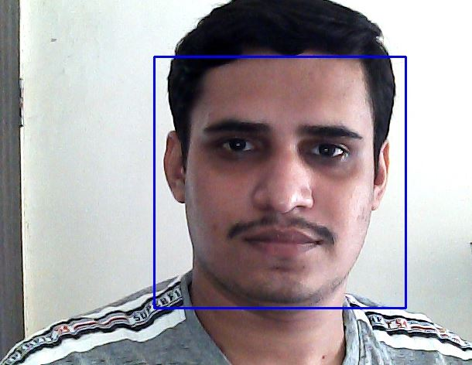
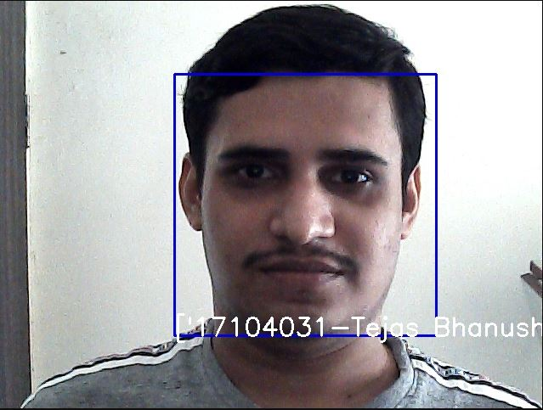
Prototype Design Demonstration
Detect face
Recognize face

Slide 21
Plan of Paper Publication
6th International Conference for Convergence in Technology 2021.
Second International Conference Secure Cyber Computing And Communications (ICSCCC) 2021.

Slide 22
Thank You...!!

